Slide 1
Path Forward Discussion
urls of exemplary web sites (with reasoning about what you appreciate about the website) to be used as examples for the OceanSITES website; and
a one-page slide with a concise and compelling summary showing and describing the importance of your OceanSITE.

Slide 2
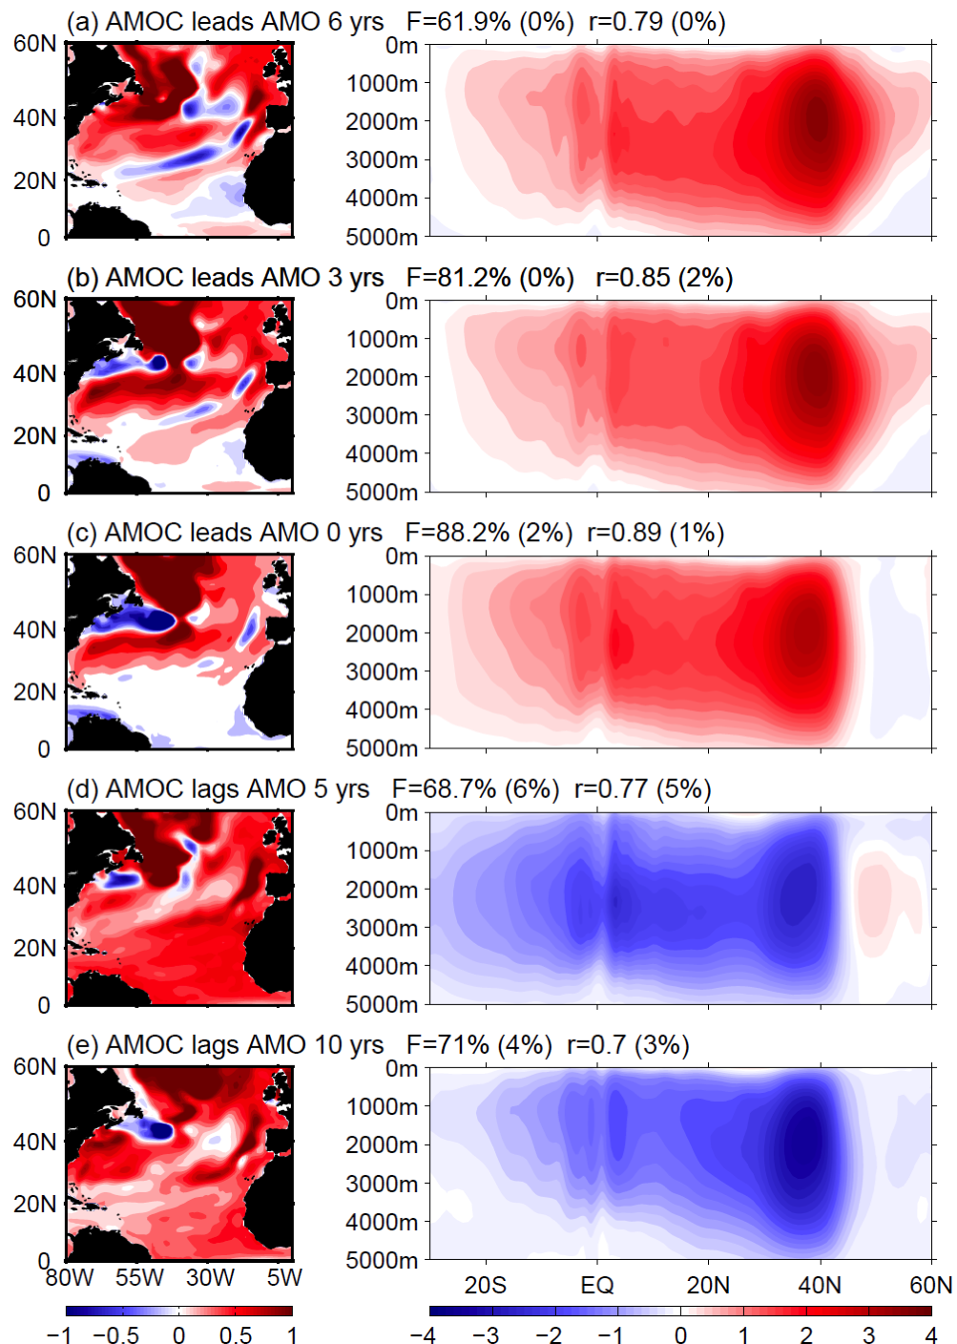
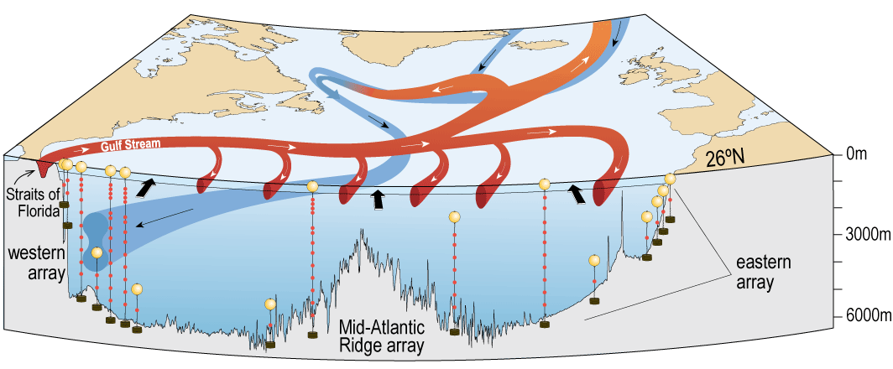
Observations of the Meridional Overturning Circulation in the North Atlantic
Impacts temperature, salinity, sea-level, and ecosystems
A strong MOC is associated with warm SST in the North Atlantic
Goals: NOAA partners with the National Science Foundation and the National Environmental Research Council to measure the MOC at 26°N.
This leverages a long term NOAA observing system program and a key NOAA strength.
Measuring the MOC supports NOAA’s mission to assess the state of the climate system and improve scientific understanding of a changing climate and its impacts.
Notes:
The 26N array is the first of its kind trans basin array that directly measures the insitu ocean components of the circulation that make up the MOC. It is built upon the long standing NOAA program to measure the Florida Current with a submarine telephone cable in the straits of Florida since 1982. The Florida Current transport has been a standard benchmark used by numerical and inverse modelers to improve ocean circulation estimates, and as well as fisherman and fishery research efforts.
Shown here is a diagram of the mooring array components that form a picket fence across the North Atlantic Ocean (left).
On the right is the resulting MOC time series at 26N (red). On this slide the MOC transport is compared to two other time series of the MOC in the North Atlantic that are incomplete: the 41N data derived from Argo data (down to 2000m) and the 16N time series derived for the flow below 1000m – representing the lower limb of the MOC.
This time series has been widely successful, generating a lot of new interest in the MOC, its variability and predictability – as well as looking at its meridional coherence (as shown here). So far we’ve learned that the MOC is much more variable than previously thought, there is a strong seasonal cycle with all components of the circulation influencing its phasing (you can see the seasonal cycle in this time series). The seasonal cycle appears to be driven predominantly by the wind stress curl in the far eastern Atlantic. We’ve also looked at long term trends for the MOC time series.

Slide 3
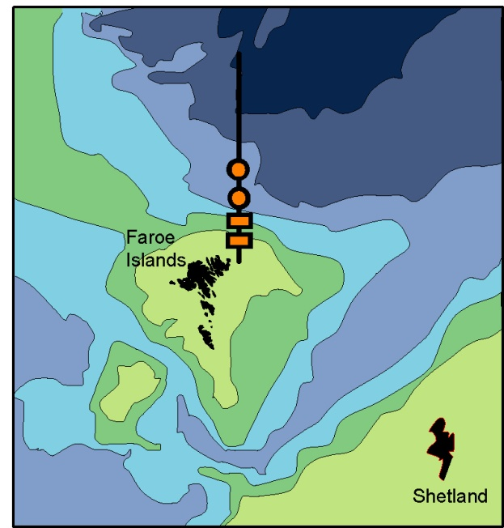
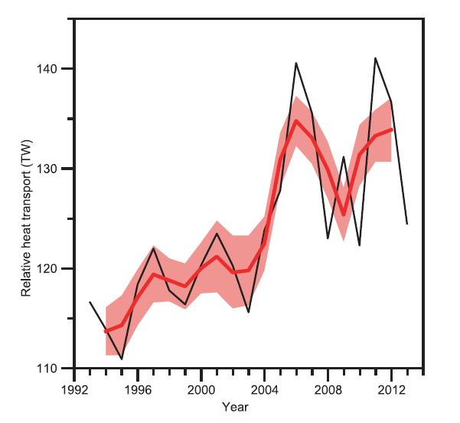
Iceland-Faroe AW inflow
(OceanSITES FAROECURR-T1 and FAROECURR-T2)
The exchanges across the Greenland-Scotland Ridge form the northern limb of the AMOC
The Iceland-Faroe Inflow of Atlantic Water is the larges of three inflowing branches with an average transport of 3.8 Sv
Over two decades (1993-2013) the volume and heat-transport in the IF-inflow increased by 9% and 18% respectively and this potentially has a large impact on Arctic sea-ice
Heat transport relative to 0°C
EU-FP7 NACLIM (http://naclim.zmaw.de/Iceland-Faroes.2468.0.html)
http://www.oceansites.org
Hansen et al, 2015. Transport of volume, heat, and salt towards the Arctic in the Faroe Current 1993–2013. Ocean Sci., 11, 743–757, 2015. www.ocean-sci.net/11/743/2015/doi:10.5194/os-11-743-2015

Slide 4
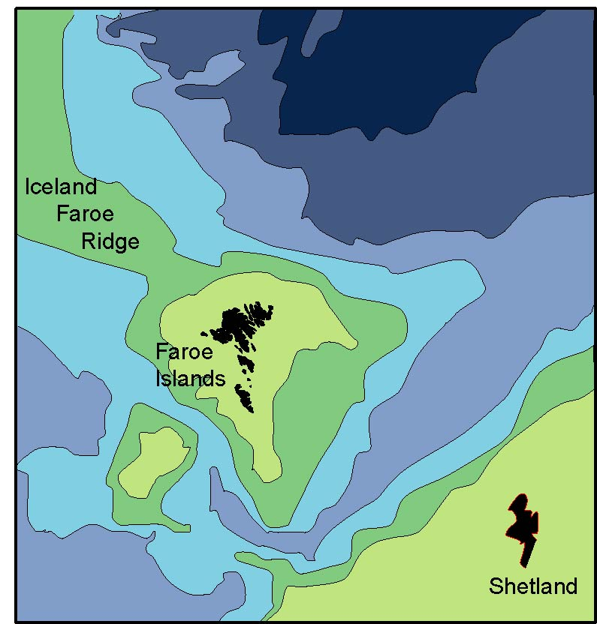
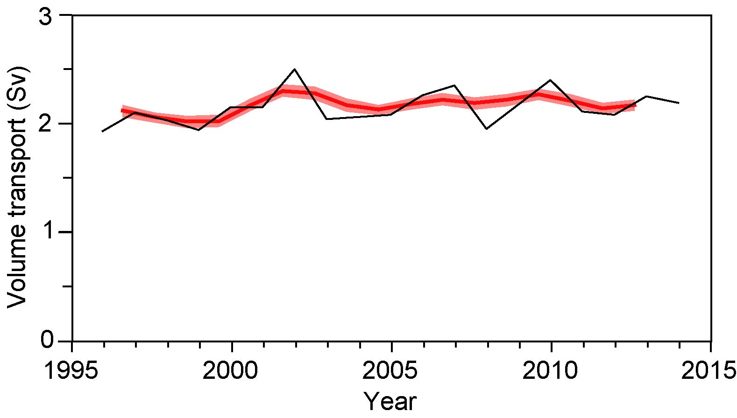
Faroe Bank Channel Overflow
(OceanSITES FAROEBCO-T1 and FAROEBCO-T2)
The exchanges across the Greenland-Scotland Ridge form the northern limb of the AMOC
Two main overflow branches cross the ridge: the Denmark Strait overflow and the Faroe Bank Channel overflow
The overflow through the Faroe Bank Channel thus is an important contribution to the global thermo-haline circulation
EU-FP7 NACLIM (http://naclim.zmaw.de/Faroe-Bank-Channel.2461.0.html)
http://www.oceansites.org
https://www.atlantos-h2020.eu/structure/wp3/
Hansen and Østerhus, 2007. Faroe Bank Channel overflow 1995–2005. Progress in Oceanography 75 (2007) 817–856
Volume transport 1995 – 2015
Mean transport 2.1 Sv
No significant trend

Slide 5
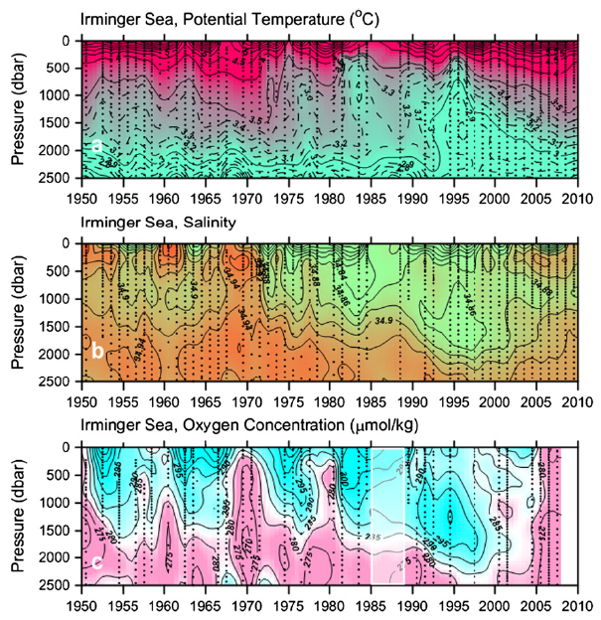
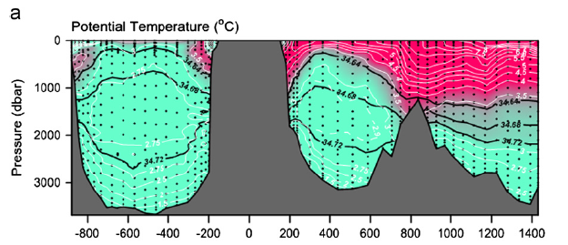
LOCO Irminger Sea time series
12-year long high resolution
data in center of the
Subpolar Gyre.
Comes with:
Near annual AR7E hydrogr. 1990-present.
Bottle data back to 1950.
OOI data till…?

Slide 6
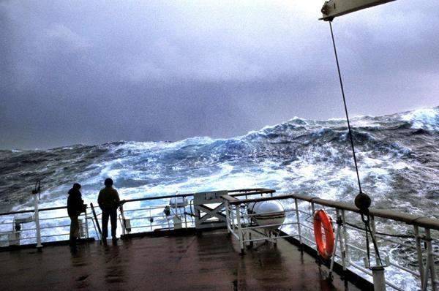
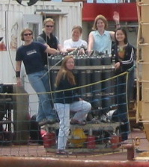
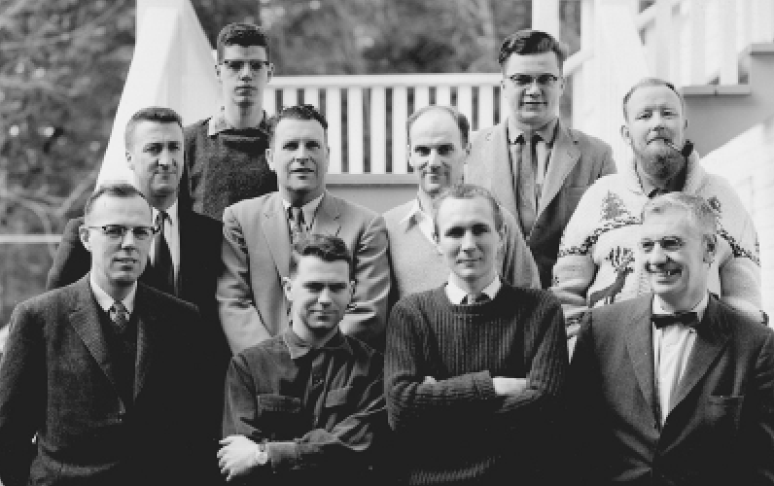
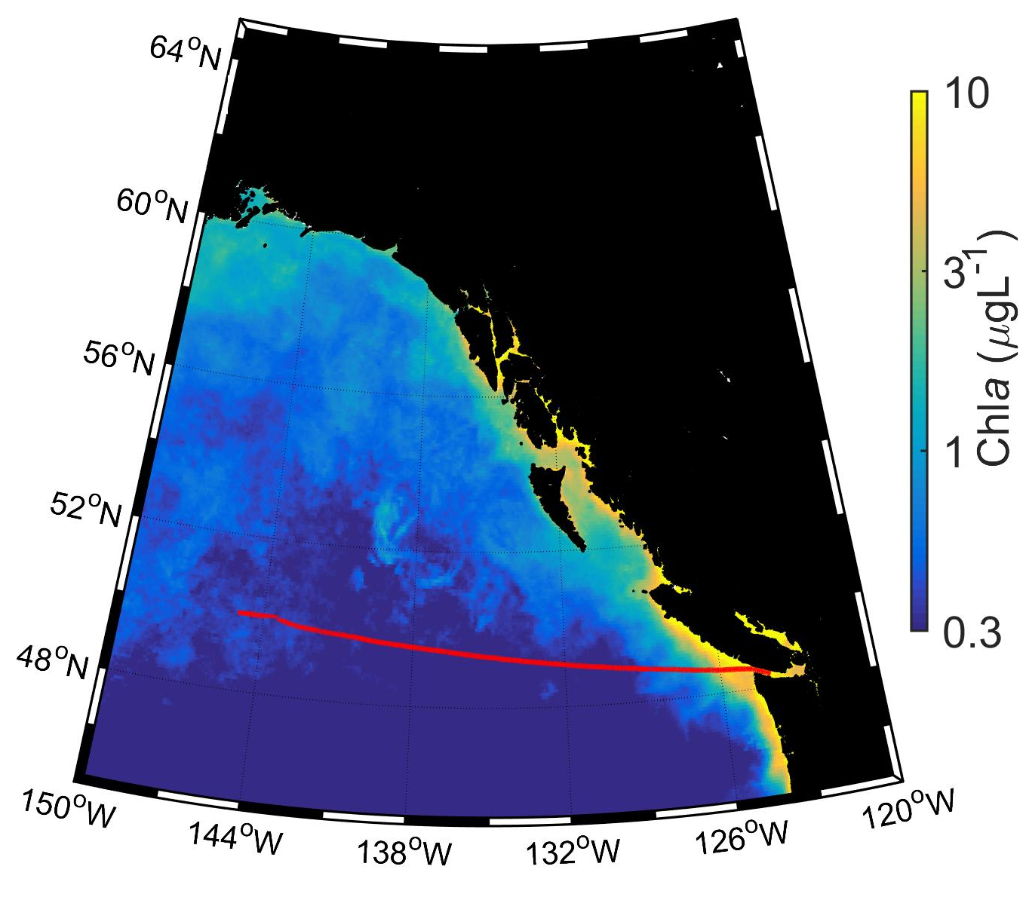
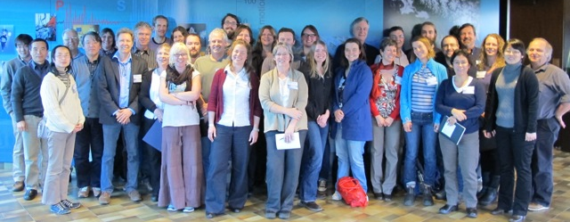
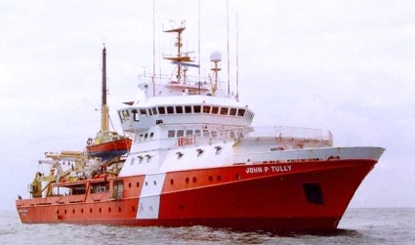
Congratulations DFO Line P Program!
60-year time series in the subarctic NE Pacific
1956 – 2016 and beyond !
Station P
Line P
Notes:
Before going any further, I want to give a Shout Out to the DFO Line P Program, which has built a 60 year time series at Station P! This is the primary reason the NOAA surface mooring is there.

Slide 7
Surface mooring (Stratus ORS) provides independent benchmark observation of wind and heat flux at sea surface – and a means to assess realism of models
ERA: -2.7 W m⁻² yr⁻¹
NCEP2: -0.8 W m⁻² yr⁻¹
Buoy: -1.5 W m⁻² yr⁻¹
ERA: 0.0014 N m⁻² yr⁻¹
NCEP2: 0.0009 N m⁻² yr⁻¹
Buoy: 0.0013 N m⁻² yr⁻¹

Slide 8
So what?
Was a model improved due to this assessment?
What does it impact that ERA was too low (HF) yet fast (wind stress)?
  Is there a physical process that mattered to someone that was too high/low in ERA because of this bias?
Can we extend the results one step further to include the societal impact?

Slide 9
Why does the Argo program succeed?
Cool Technology
  OceanSITEs has this too – just perhaps too many!
Measures something completely – can synthesize a story that completely covers a topic
  E.g. ”Where’s the missing heat?” – the miss-match between upper ocean heat content estimates and
  Overarching science question addressed by the whole array is not site or platform dependent
Has an external customer (beyond scientific understanding)
  Model initialization – data is critical to remove model bias

Slide 10
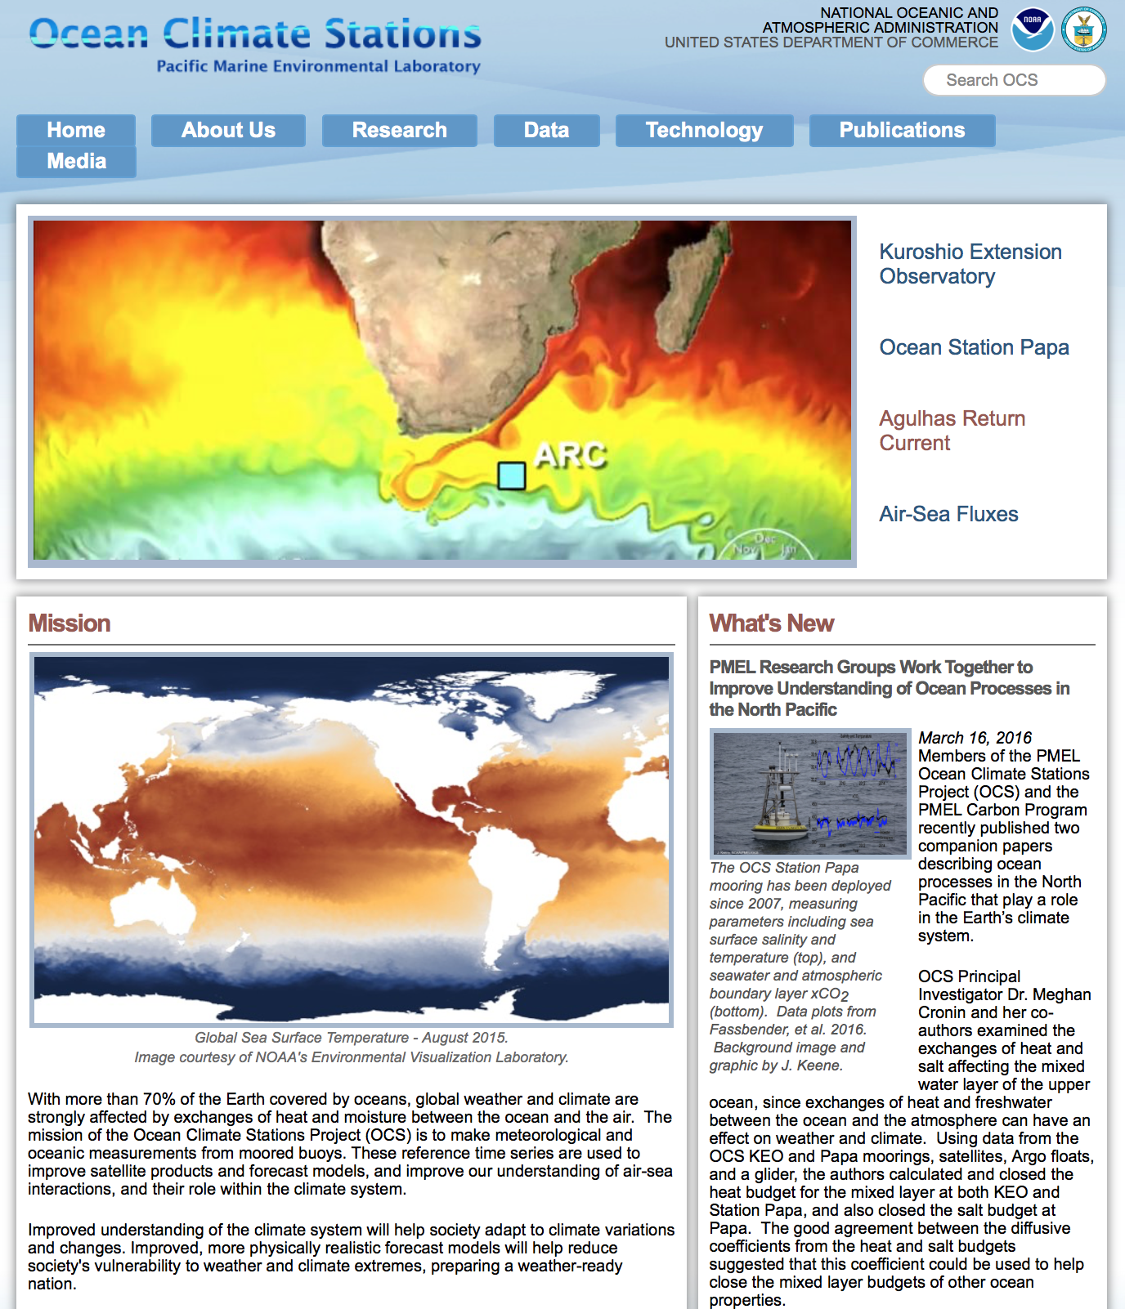
Web Page Best Practices:
* Serves "Best available data" for any time period requested with all deployment files stitched together. (OceanSITES should give choice to user of accessing original deployment by deployment files with all redundant data, or the stitched together best available data.)
* Data Display & Delivery page. Displays are publication quality.
* Publication list is sortable
* Links to partner pages and partner data

Slide 11
Why OceanSITES?
Promote the time series sites
  Collect short web features of the “so what” results from publications, cruises, meetings, etc.
  Collect examples of model improvements, societal benefit concrete links
  Powerpoint slide summaries
Collect data
    Single out a user community to help – provide what they need and what we can deliver
    Provide best time series, higher level products

Slide 12
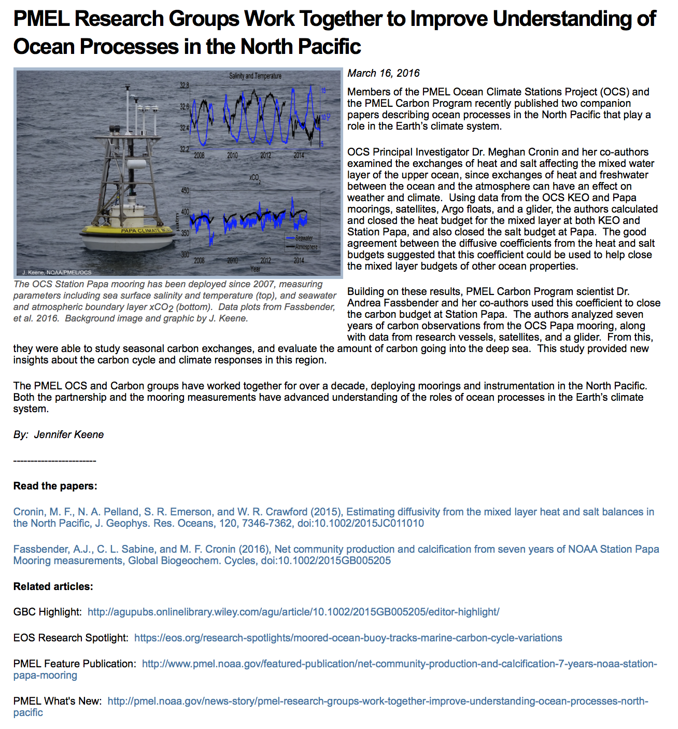
Short
Focused
Timely
Linked to papers, web sites, etc

Slide 13
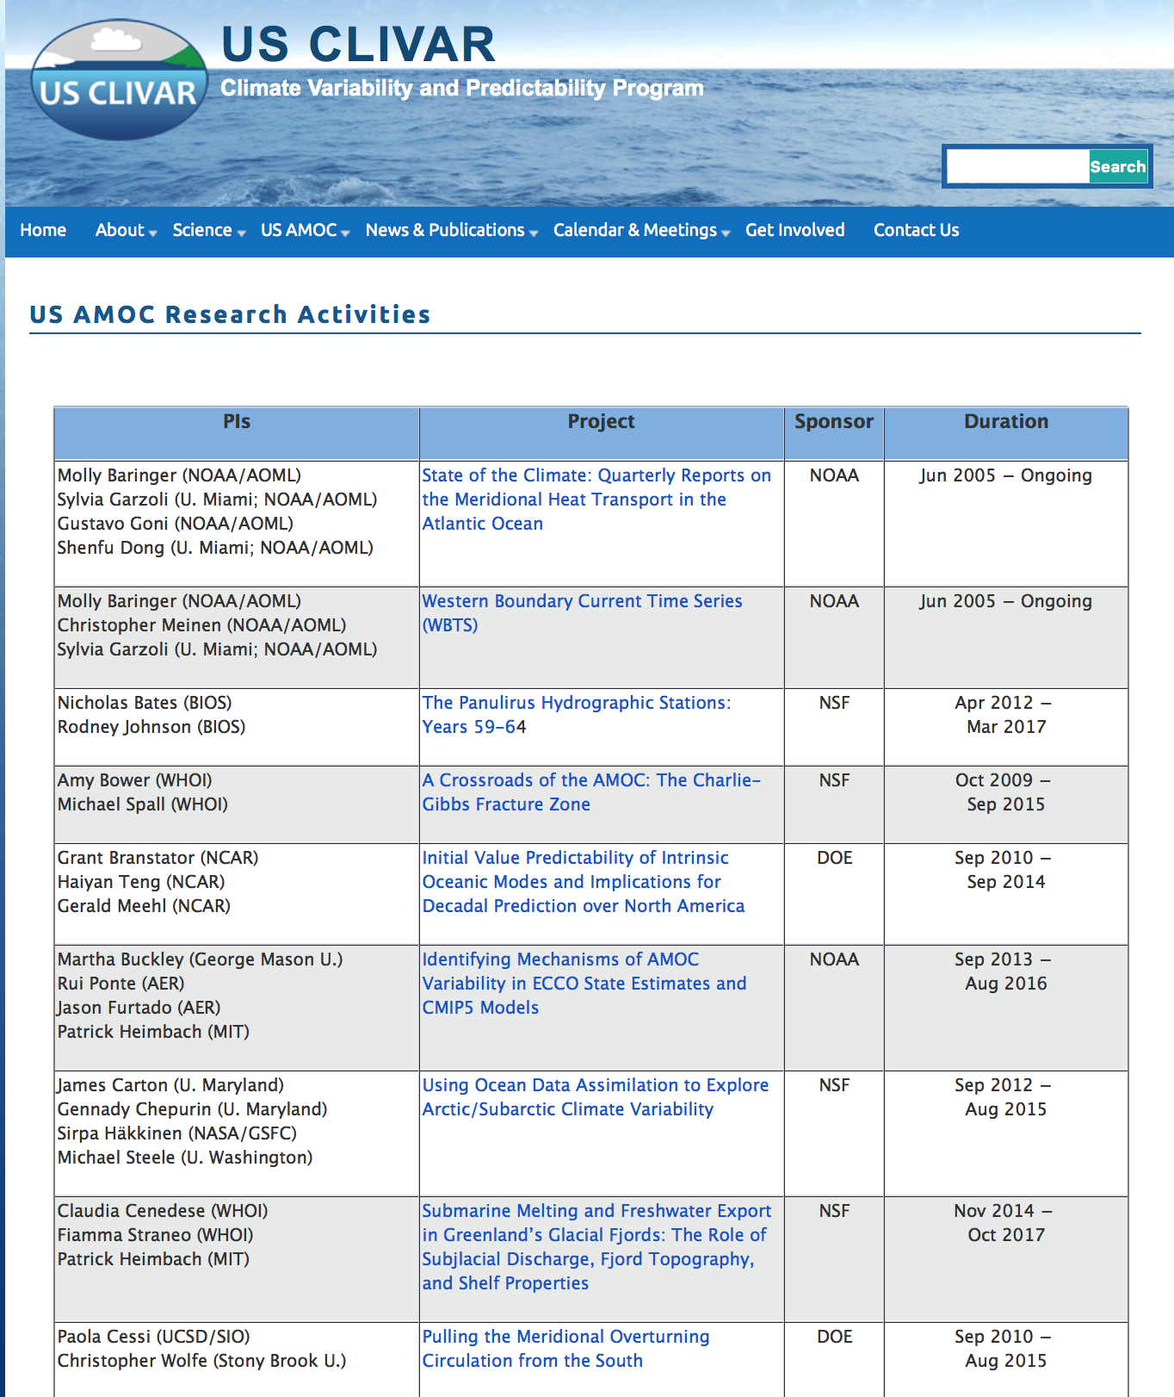
Provide a home for
existing derived products/time series
Project summaries of OceanSITEs stations

